Slide 1


Data protection strategy the 3-2-1 backup rule
Training module
cpr101Nff group 14

Slide 2
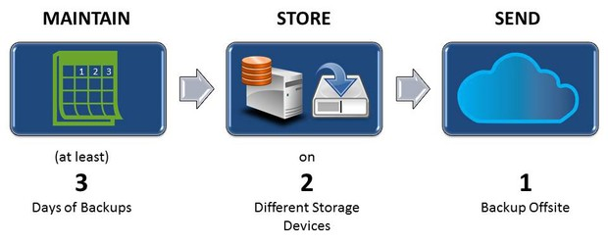
The 3-2-1 Backup Rule – An Efficient Data Protection Strategy

Slide 3
Why do we need it?
Backups ensure that your critical data will survive any of the likely hazards. Too many individuals and companies have suffered from having their hardware lost or stolen, destroyed by fires or natural disasters, infected with malware or corrupted by targeted hacker attacks. Common sense dictates that all hard drives will eventually fail; the question is whether or not you are prepared for the worst-case scenario.

Slide 4
The rule
The 3-2-1 backup rule is an easy-to-remember acronym for a common approach to keeping your data safe in almost any failure scenario. The rule is: keep at least three (3) copies of your data, and store two (2) backup copies on different storage media, with one (1) of them located offsite.

Slide 5
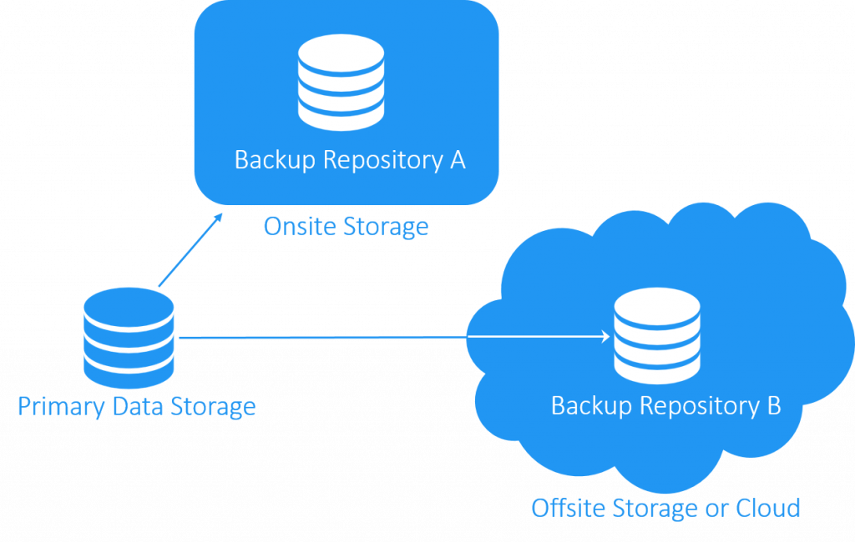
Three copies of your data:
One copy is the production data (the original data that you use for real-world) purposes. The other two copies are backups. Each copy of the data, the production copy and the two backups should be stored and configured in such a way that it will remain intact even if the other copies fail or disappear. Finally, each of these copies should contain the same version of the data. In other words, you don’t satisfy this rule if you have one copy of data from a backup that you performed yesterday, and two other copies that were created last week. All copies should contain the same data from the same point in time. We can use cloud storages like Google Drive, Dropbox, OneDrive etc. for our free cloud backups.
Two storage media for your data:
Second, at least two of the copies of your data should exist on storage devices that are physically independent from each other. For example, one could be on a hard drive inside a server, and another could be a flash drive or USB that is not attached to the server
One data copy should exist offsite:
The third and final part of the 3-2-1 backup rule is that at least one copy of your data should exist in an offsite location, meaning one that is physically located in a different place than other copies.

Slide 6
Summary
The 3-2-1 backup rule protect your files and important documents, folders, etc. from losing your primary data together with its only backup copy, whereas storing copies of data in multiple locations ensures that there is no single point of failure and that your data is safe, should something happen to any of these locations. Testing is also important, what if these data gets lost? So, it is important to test your backups and modify them also.
The 3-2-1 backup rule is a good recommended start in building any data protection system – a way to protect your data from corruption and to control risks in all of the aforementioned situations. Being well prepared in advance is the best data protection policy.

Slide 7
Thank you
References: 1. Google
2. Course notes
3. https://www.nakivo.com/blog/3-2-1-backup-rule-efficient-data-protection-strategy/#:~:text=The%203%2D2%2D1%20backup%20rule%20is%20an%20easy%2D,1)%20of%20them%20located%20offsite.

